Slide 1

Development of a knowledge base of Ti-alloys from first-principles and computational thermodynamics
Cassie Marker
Department of Materials Science and Engineering
Advisor: Dr. Zi-Kui Liu
5/10/17

Slide 2
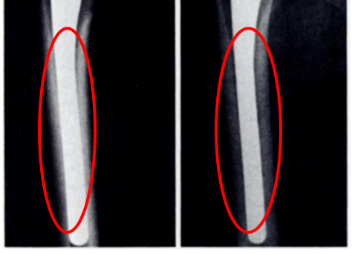
Background: Ti-alloys Biomedical Applications
Ti-Mo-Nb-Sn-Ta-Zr system
Elastic properties
Thermodynamics and phase stability
Alloy | Young’s Modulus (GPa)
Bone | 10-40
Ti | 105
Ti-6Al-4V | 110
Stainless Steel | 200
CoCrMo | 200-230
A
B
M. Long, H.J. Rack, Biomaterials. 19 (1998) 1621–1639.
Engh C., Bobyn J., Glassman A., Journal of Bone & Joint Surgery, 69 (1987) 45-55.
Notes:
2010 1,061,000 total knee and hip replacements, double by 2020, 14% of hip and 10% of knee replacements were revision surgeries. Focus on biocompatibility fatigue strength, corrosion and young’s modulus

Slide 3
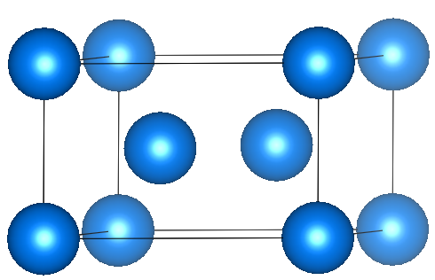
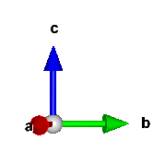
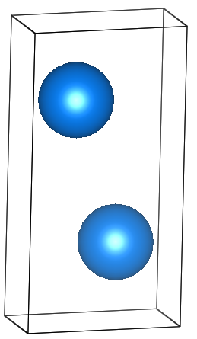
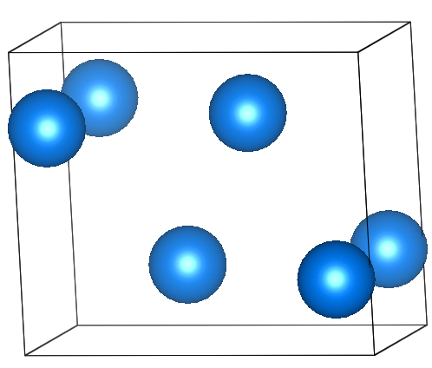
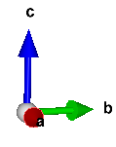
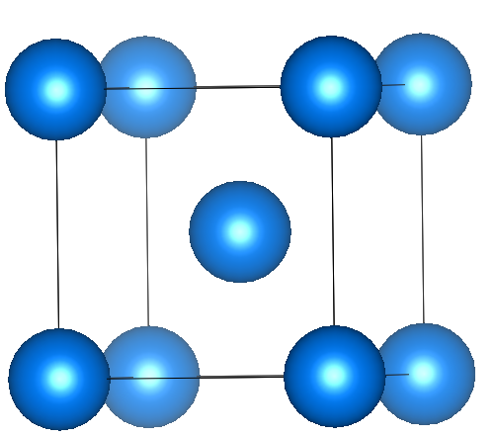
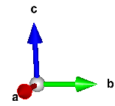
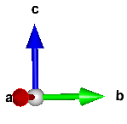
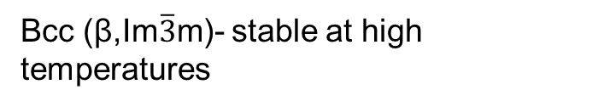
Phase Stabilities
ω (P6/mmm)- hexagonal metastable phase
Hcp (α,P6₃/mmc) Standard element reference state of Ti. Stable at room temperature
Alloy | Phase | Young’s Modulus
Ti | α | 105
Ti-6Al-4V | α+β | 110
Ti-35Nb-5Ta-7Zr | β | 55
Ti-13Nb-13Zr | α“+β | 79
Ti-25Nb-Ta-Zr | α+ω | 88
α“(Cmcm)-orthorhombic martensitic transformation-displacive
Bcc (β,Im$\overline{3}$m)- stable at high temperatures
A. Jain*, S.P. Ong*, G. Hautier, W. Chen, W.D. Richards, S. Dacek, S. Cholia, D. Gunter, D. Skinner, G. Ceder, K.A. Persson APL Materials, 2013, 1(1), 011002.
M. Long, H.J. Rack, Biomaterials. 19 (1998) 1621–1639.
Notes:
alpha”-martensitic transformation is displacive. Thermodynamically the martensitic transformation is first-order and initiated by supercooling. An applied stress can also contribute to the driving force for a martensitic transformation. Kinetically the martensitic transformation propagates in an athermal manner.
Omega-form athermally when Ti is alloyed with beta stabilizing elements such as Mo, Nb and Ta.

Slide 4
Objectives
Study equilibrium phase stability and elastic properties of Ti-alloys
Establish a thermodynamic and elastic database for the Ti-Mo-Nb-Sn-Ta-Zr system
Study metastable phase stability of Ti alloys
Study the elastic properties, phase stability and transformation of α” and ω phases

Slide 5
Objectives
Study equilibrium phase stability and elastic properties of Ti-alloys
Establish a thermodynamic and elastic database for the Ti-Mo-Nb-Sn-Ta-Zr system
Study metastable phase stability of Ti alloys
Study the elastic properties, phase stability and transformation of α” and ω phases

Slide 6
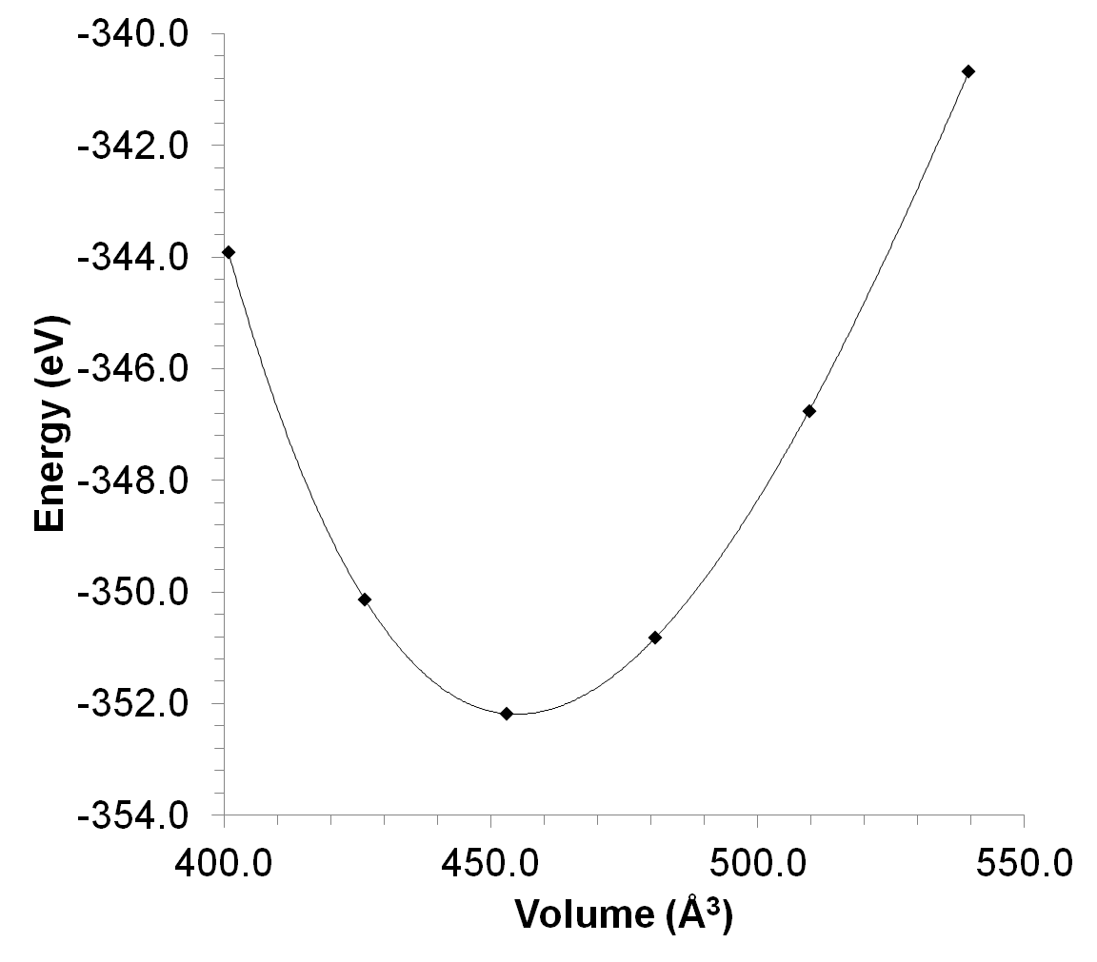
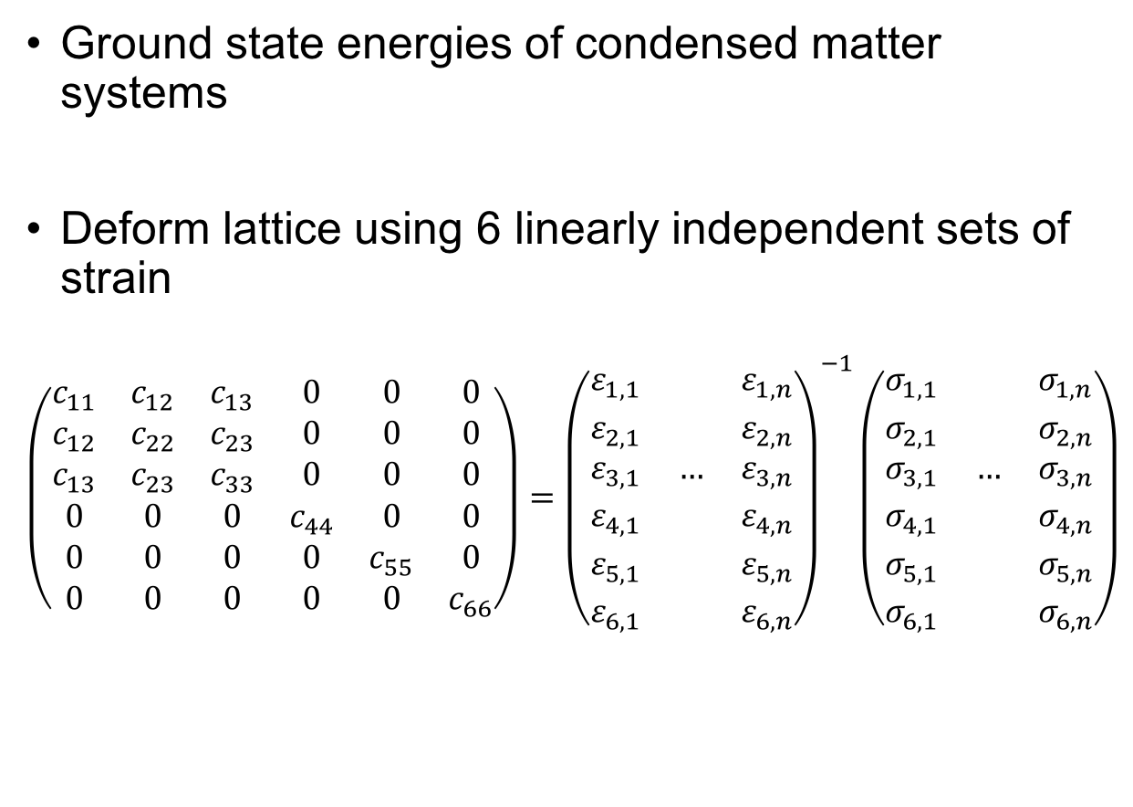
First-principles based on DFT 0 K
Ground state energies of condensed matter systems
Deform lattice using 6 linearly independent sets of strain
$$\left(\begin{matrix}c_{11} & c_{12} & c_{13} & 0 & 0 & 0 \\ c_{12} & c_{22} & c_{23} & 0 & 0 & 0 \\ c_{13} & c_{23} & c_{33} & 0 & 0 & 0 \\ 0 & 0 & 0 & c_{44} & 0 & 0 \\ 0 & 0 & 0 & 0 & c_{55} & 0 \\ 0 & 0 & 0 & 0 & 0 & c_{66}\end{matrix}\right)={\left(\begin{matrix}ε_{1,1} & & ε_{1,n} \\ ε_{2,1} & & ε_{2,n} \\ ε_{3,1} & … & ε_{3,n} \\ ε_{4,1} & & ε_{4,n} \\ ε_{5,1} & & ε_{5,n} \\ ε_{6,1} & & ε_{6,n}\end{matrix}\right)}^{−1}\left(\begin{matrix}σ_{1,1} & & σ_{1,n} \\ σ_{2,1} & & σ_{2,n} \\ σ_{3,1} & … & σ_{3,n} \\ σ_{4,1} & & σ_{4,n} \\ σ_{5,1} & & σ_{5,n} \\ σ_{6,1} & & σ_{6,n}\end{matrix}\right)$$
E_{0K} EOS fitting: static ground state energy of the crystal
S.L. Shang et al., Comput. Mater. Sci. 47 (2010) 1040–1048.; Y. Wang et al., Acta Mater. 52 (2004) 2665–2671.; A. Wang et al., Calphad. 37 (2012) 126–131.

Slide 7
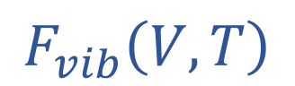

Finite temperature properties
$$F\left(V,T\right)=E_{0K}\left(V\right)+F_{vib}\left(V,T\right)+F_{T−el}\left(V,T\right)$$
Temperature-dependent crystal vibrations, obtained from the Debye-Grüneisen model or phonon supercell approach
$$F_{vib}\left(V,T\right)$$
$$F_{T−el}\left(V,T\right)$$
Temperature-dependent thermal-electronic excitation contributions to the Helmholtz energy
S.L. Shang et al., Comput. Mater. Sci. 47 (2010) 1040–1048.; Y. Wang et al., Acta Mater. 52 (2004) 2665–2671.; A. Wang et al., Calphad. 37 (2012) 126–131.
Notes:
where E₀ is the static contribution at 0 K without the contribution of zero-point vibrational energy, F_{Vib} the temperature-dependent vibrational contribution, and F_{T-el} the thermal electronic contribution. At ambient pressure, the Helmholtz energy of the system is equal to the Gibbs energy, which is used in the CALPHAD modeling F_{T-el} based on electronic density of states and calculated with Fermi-Dirac statistics E_{el}-Ts_{el}

Slide 8

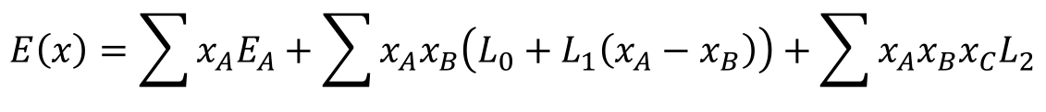
CALculations of PHAse Diagrams (CALPHAD)
Fewer data points supplemented by first-principles calculations
Experimental data plenty, hard to predict using first-principles
Thermochemical data: enthalpy entropy, heat capacity, activity …
Phase equilibria data: liquidus, solidus, phase boundary/composition
Gibbs energy (parameterized)
Practical applications: T, P, ni
http://www.calphad.org
Phase diagrams, direct applications
$$G_{m}^{∅}=x_{i}{}_{}^{0}{G_{i}^{∅}+x_{j}{}_{}^{0}{G_{j}^{∅}+RT\left[x_{i}\ln\left(x_{i}\right)+x_{j}\ln\left(x_{j}\right)\right]+{}_{}^{XS}{G_{m}^{∅}}}}$$
$$E\left(x\right)=\sum{x_{A}E_{A}}+\sum{x_{A}x_{B}\left(L_{0}+L_{1}\left(x_{A}−x_{B}\right)\right)}+\sum{x_{A}x_{B}x_{C}L_{2}}$$
Z.-K. Liu, J. Phase Equilibria Diffus. 30 (2009) 517–534.; Z.-K. Liu, H. Zhang, S. Ganeshan, Y. Wang, S.N. Mathaudhu, Scr. Mater. 63 (2010) 686–691.

Slide 9
Ti-Mo-Nb-(Sn)-Ta-Zr Database Objectives
Pure elements → Binary → Ternary → Multi-component
Ti-Mo
Ti-Nb
Ti-Sn
Ti-Ta
Ti-Zr
Mo-Nb
Mo-Sn
Mo-Ta
Nb-Sn
Nb-Ta
Nb-Zr
Sn-Ta
Sn-Zr
Ta-Zr
Mo-Zr
Ti-Mo-Nb
Ti-Mo-Ta
Ti-Mo-Zr
Ti-Nb-Ta
Ti-Nb-Zr
Ti-Ta-Zr
Literature
Present work
Future

Slide 10
Pure element thermodynamic benchmark
Pure Elements |  | E₀ (eV/atom) | a (Å) | c (Å) | B (GPa)
hcp-Ti | This work | -7.80 | 2.92 | 4.6 | 113
 | Expt [1-2] |  | 2.96 | 4.7 | 110
Bcc-Mo | This work | -10.84 | 2.74 | - | 262
 | Expt [3-4] |  | 2.72 | - | 261
Bcc-Nb | This work | -10.22 | 2.86 | - | 171
 | Expt [5-6] |  | 2.86 | - | 172
Bcc-Ta | This work | -11.85 | 2.87 | - | 196
 | Expt [5-7] |  | 2.86 | - | 196
hcp-Zr | This work | -8.51 | 3.04 | 4.98 | 94
 | Expt [8-9] |  | 3.23 | 5.15 | 97
[1] M. J. and N. Z. and M. N. and A. J. and M. Lame, Phys. Scr., vol. 83, no. 6, p. 65603, 2011. [2] A. V Dobromyslov and N. I. Taluts, Phys. Met. Met., vol. 63, no. 1, pp. 114–120, 1987.; [3] J.M. Dickinson, P.E. Armstrong, J. Appl. Phys. 38 (1967) 602–606.; [4] H. T. Tsai and A. Muan, J. Am. Ceram. Soc., vol. 75, no. 6, pp. 1412–1415, 1992. [5] D.I. Bolef, J. Appl. Phys. 32 (1961) 100–105; [6] D. Steinbinder, H. Wipf, A. Magerl, D. Richter, A.-J. Dianoux, and K. Neumaier, EPL (Europhysics Lett., vol. 6, no. 6, p. 535, 1988.; [7] V. V Vavilova, L. N. Galkin, and M. V Glazov, in Dokl. Akad. Nauk SSSR, 1988, vol. 300, no. 5, pp. 1157–1161.; [8] Q. Peng et al., Sci. Rep., vol. 4, p. 5735, Jul. 2014.; [9] A. I. K. and A. M. B. and I. O. B. and A. V. B. and E. G. P. and M. Prager, J. Phys. Condens. Matter, vol. 6, no. 43, p. 8977, 1994.

Slide 11
Thermodynamic Modeling-Binary Systems
BCC Phase
Y.L. Zhang, H.S. Liu, Z.P. Jin, Calphad-Computer Coupling Phase Diagrams Thermochem. 25 (2001) 305–317.; T. Uesugi, S. Miyamae, K. Higashi, Mater. Trans. 54 (2013) 484–492.

Slide 12
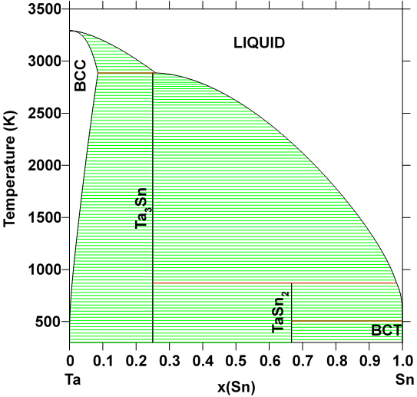
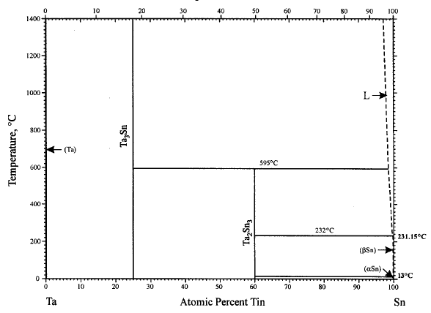
Ta-Sn Thermodynamic Modeling
Observed Phases: bct Sn, diamond Sn, bcc, Ta₃Sn, TaSn₂
H. Okamoto, Sn-Ta (Tin-Tantalum), J. Phase Equilibria. 24 (2003) 484.

Slide 13
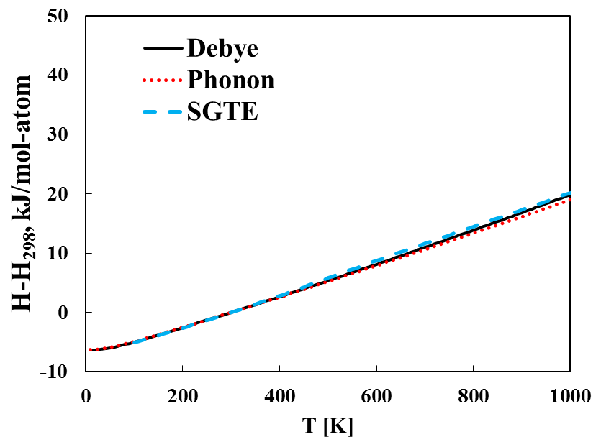
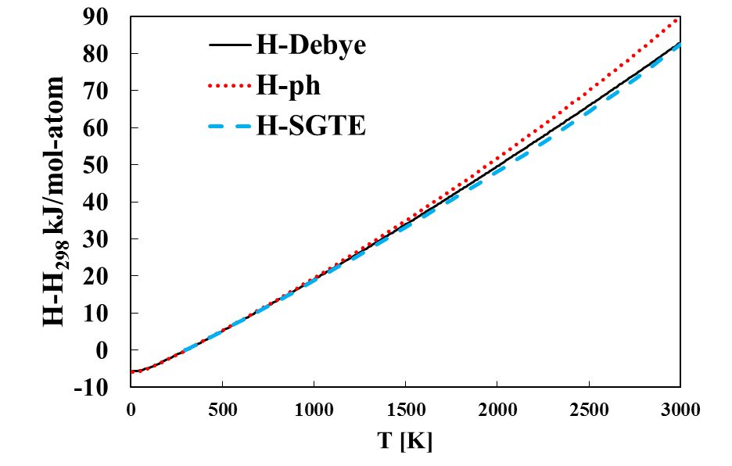
Calculated the pure elements
Bcc Ta
Bct Sn
A.T. Dinsdale, CALPHAD. 15 (1991) 317–425.

Slide 14
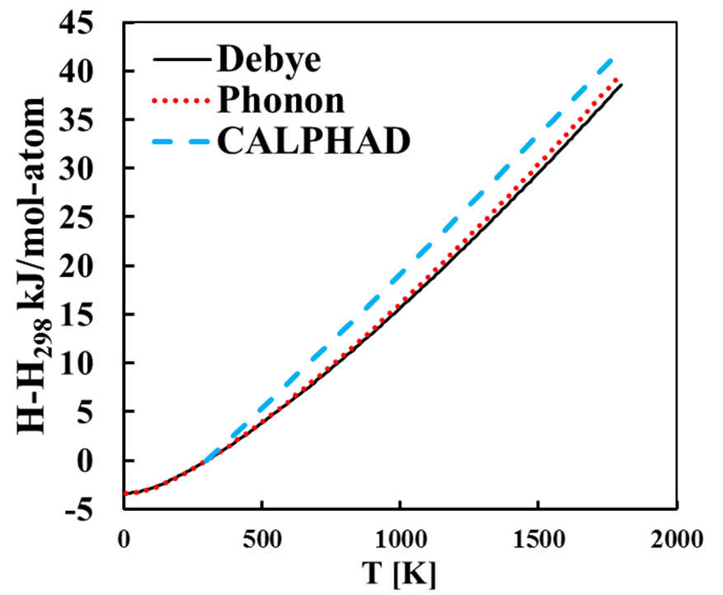
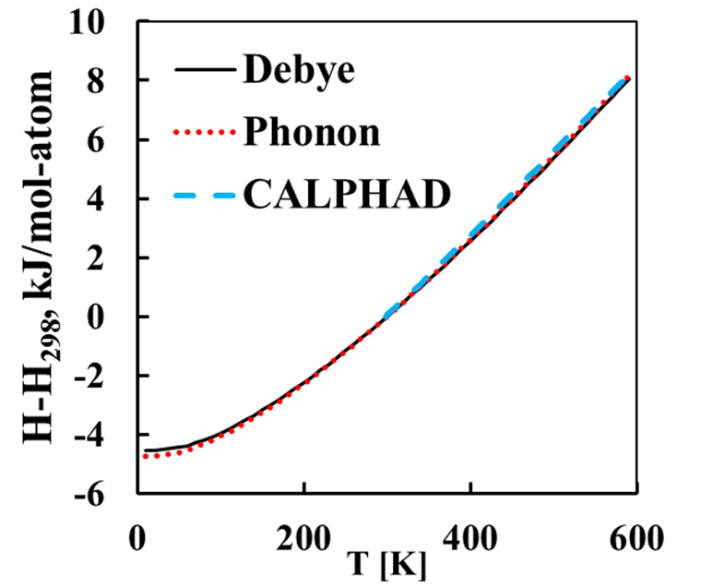
Calculated the Stoichiometric compounds
Ta₃Sn
TaSn₂

Slide 15
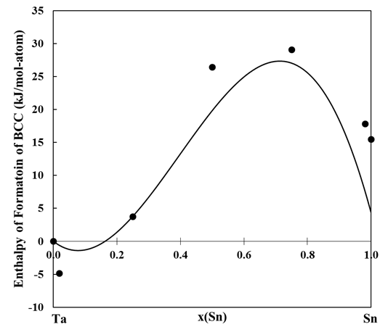
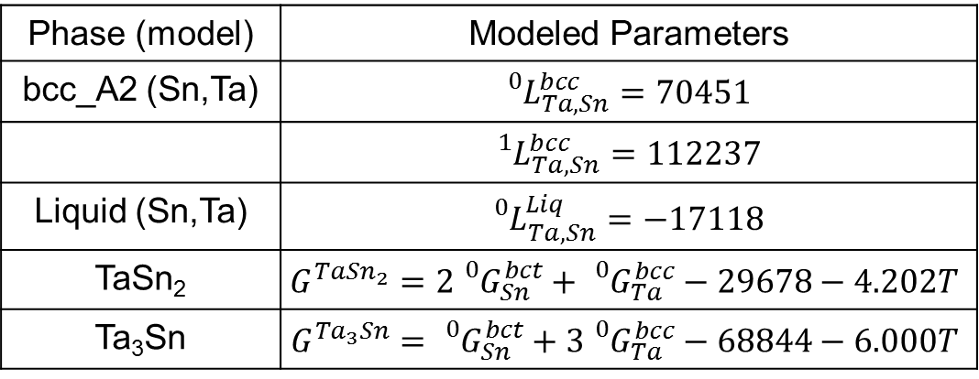
Enthalpy of Formation and Modeled Parameters
Phase (model) | Modeled Parameters
bcc_A2 (Sn,Ta) | $${}_{}^{0}{L_{Ta,Sn}^{bcc}=70451}$$
 | $${}_{}^{1}{L_{Ta,Sn}^{bcc}=112237}$$
Liquid (Sn,Ta) | $${}_{}^{0}{L_{Ta,Sn}^{Liq}=−17118}$$
TaSn₂ | $$G^{Ta{Sn}_{2}}=2{}_{}^{0}{G_{Sn}^{bct}+{}_{}^{0}{G_{Ta}^{bcc}}−29678−4.202T}$$
Ta₃Sn | $$G^{{Ta}_{3}Sn}={}_{}^{0}{G_{Sn}^{bct}+3{}_{}^{0}{G_{Ta}^{bcc}}−68844−6.000T}$$

Slide 16
Thermodynamic Modeling-Ti-X-Y
o-phase boundary
•-single-phase
◑-two-phase
673 K
823 K
Phase | Parameters | Value
BCC_A2 (Nb,Ta,Ti) |  | -136603
 |  | -136602
673 K
823 K
L. Na, W.H. Warnes, Ieee Trans. Appl. Supercond. 11 (2001) 3800–3803.

Slide 17
Pure elements elastic properties benchmark
Pure Elements |  | C₁₁ (GPa) | C₁₂ (GPa) | C₄₄ (GPa) | B (GPa)
Bcc-Ti | This work | 93 | 115 | 41 | 107
 | FP [1] | 96 | 116 | 40 | 107
Bcc-Mo | This work | 475 | 164 | 108 | 268
 | Expt [2] | 473 | 160 | 109 | 261
Bcc-Nb | This work | 245 | 144 | 27 | 178
 | Expt [3] | 247 | 135 | 29 | 172
Bcc-Ta | This work | 278 | 164 | 81 | 202
 | Expt [3] | 267 | 161 | 83 | 196
Bcc-Sn | This work | 50 | 52 | 29 | 52
 | FP [1] | 30 | 60 | 18 | 48
Bcc-Zr | This work | 86 | 91 | 32 | 89
 | FP [1] | 82 | 94 | 30 | 90
[1] S.L. Shang et al., Comput. Mater. Sci. 48 (2010) 813–826.; [2] J.M. Dickinson et al., J. Appl. Phys. 38 (1967) 602–606.; [3] D.I. Bolef, Appl. Phys. 32 (1961) 100–105.

Slide 18
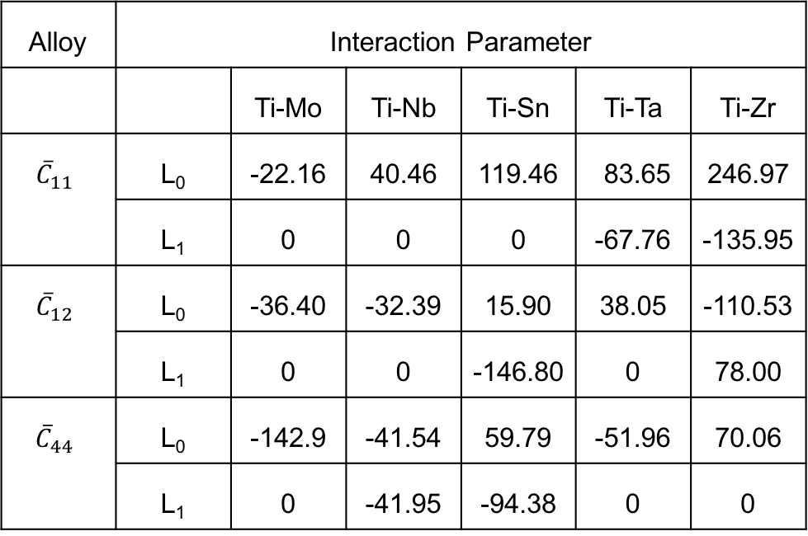
Elastic Modeling- Ti-X C_{ij}
Alloy | Interaction Parameter
 |  | Ti-Mo | Ti-Nb | Ti-Sn | Ti-Ta | Ti-Zr
$${\overline{C}}_{11}$$ | L₀ | -22.16 | 40.46 | 119.46 | 83.65 | 246.97
 | L₁ | 0 | 0 | 0 | -67.76 | -135.95
$${\overline{C}}_{12}$$ | L₀ | -36.40 | -32.39 | 15.90 | 38.05 | -110.53
 | L₁ | 0 | 0 | -146.80 | 0 | 78.00
${\overline{C}}_{44}$ | L₀ | -142.9 | -41.54 | 59.79 | -51.96 | 70.06
 | L₁ | 0 | -41.95 | -94.38 | 0 | 0
H. Ikehata, N. Nagasako, T. Furuta, A. Fukumoto, K. Miwa, T. Saito, Phys. Rev. B. 70 (2004) 174113.

Slide 19
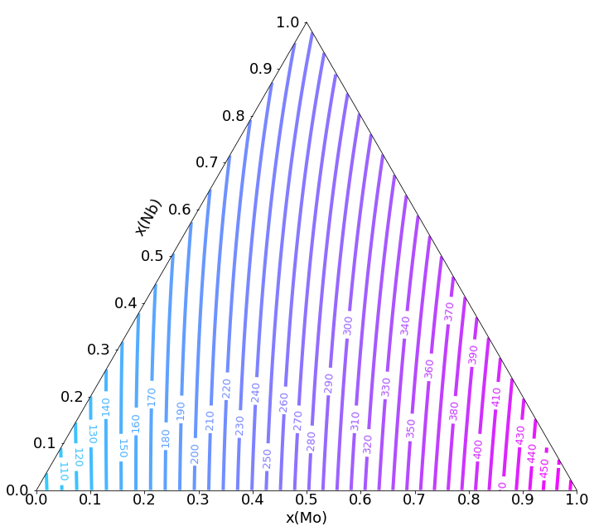
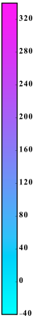
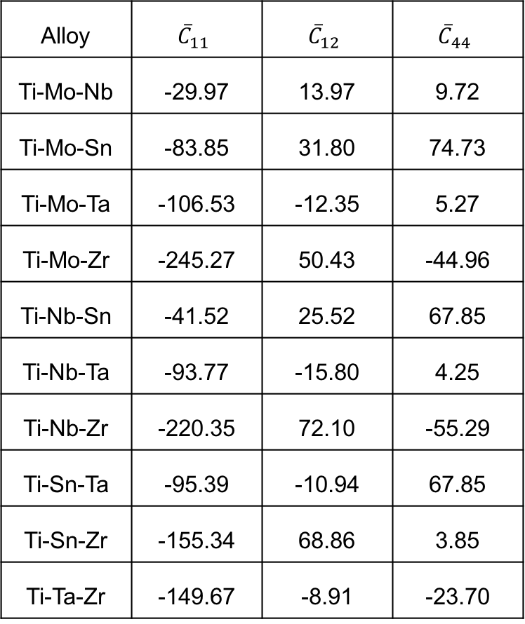
Elastic Modeling- Ti-X-Y C_{ij}
Alloy | $${\overline{C}}_{11}$$ | $${\overline{C}}_{12}$$ | $${\overline{C}}_{44}$$
Ti-Mo-Nb | -29.97 | 13.97 | 9.72
Ti-Mo-Sn | -83.85 | 31.80 | 74.73
Ti-Mo-Ta | -106.53 | -12.35 | 5.27
Ti-Mo-Zr | -245.27 | 50.43 | -44.96
Ti-Nb-Sn | -41.52 | 25.52 | 67.85
Ti-Nb-Ta | -93.77 | -15.80 | 4.25
Ti-Nb-Zr | -220.35 | 72.10 | -55.29
Ti-Sn-Ta | -95.39 | -10.94 | 67.85
Ti-Sn-Zr | -155.34 | 68.86 | 3.85
Ti-Ta-Zr | -149.67 | -8.91 | -23.70
Nb
C₁₁
Ti
Mo

Slide 20
Calculation of the Young’s modulus
H. Ikehata, N. Nagasako, T. Furuta, A. Fukumoto, K. Miwa, T. Saito, Phys. Rev. B. 70 (2004) 174113.; T. Ozaki, H. Matsumoto, S. Watanabe, S. Hanada, Mater. Trans. 45 (2004) 2776–2779.; R.R. Boyer, G. Welsch, E.W. Collings, ASM Int. Mater. Park. OH. (1994).; M.T. Mohammed, Z.A. Khan, A.N. Siddiquee, Int. J. Chem. Mol. Nucl. Mater. Metall. Eng. 8 (2014) 788–793.; F. Nozoe, H. Matsumoto, T.K. Jung, S. Watanabe, T. Saburi, S. Hanada, Mater. Trans. 48 (2007) 3007–3013.; M. Niinomi, M. Nakai, J. Hieda, Acta Biomater. 8 (2012) 3888–3903.

Slide 21
Ensuring Database Accuracy
Database Comparison
Binary interaction parameters- 0.69 to 14 GPa on average variance of 7 GPa
Ternary interaction parameters-0.39 to 13 GPa on average variance of 5 GPa
M. Tane, S. Akita, T. Nakano, K. Hagihara, Y. Umakoshi, M. Niinomi, H. Mori, H. Nakajima, Acta Mater. 58 (2010) 6790–6798.; M.T. Mohammed, Z.A. Khan, A.N. Siddiquee, Int. J. Chem. Mol. Nucl. Mater. Metall. Eng. 8 (2014) 788–793.; M. Geetha, A.K. Singh, R. Asokamani, A.K. Gogia, Prog. Mater. Sci. 54 (2009) 397–425.

Slide 22
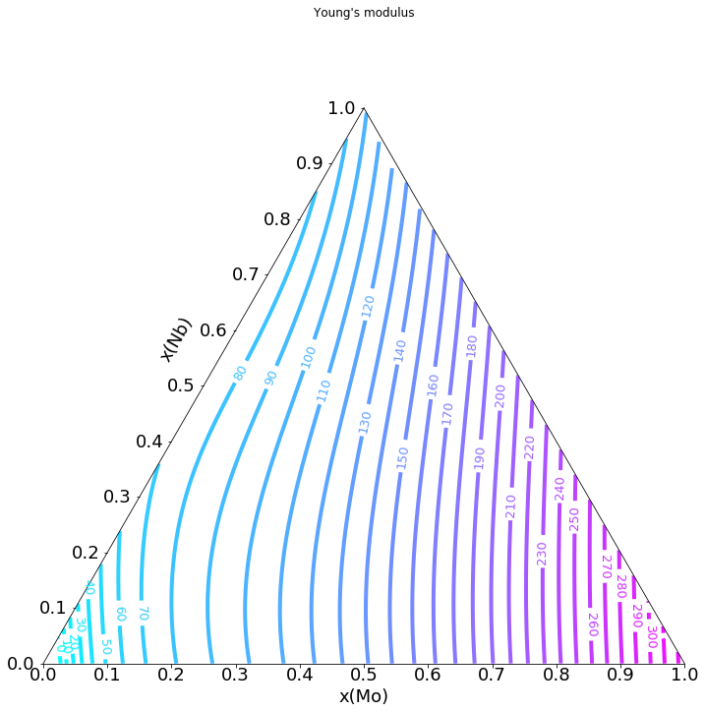
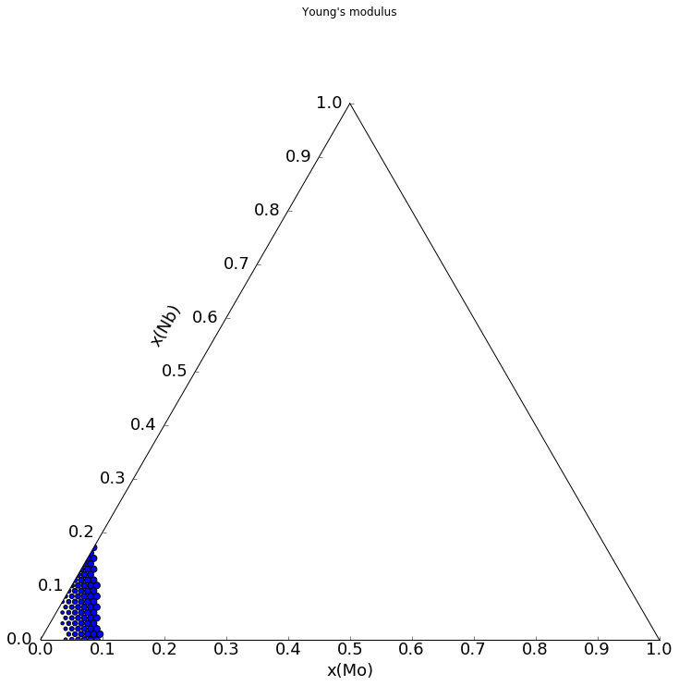
Young’s Modulus Mapping from the Database
Nb
Nb
Ti
Mo
Ti
Mo
R. Otis, Z.-K. Liu, J. Open Res. Softw. 5 (2017) 1–11.

Slide 23
Objectives
Study equilibrium phase stability and elastic properties of Ti-alloys
Establish a thermodynamic and elastic database for the Ti-Mo-Nb-Sn-Ta-Zr system
Study metastable phase stability of Ti alloys
Study the elastic properties, phase stability and transformation of α” and ω phases

Slide 24
Metastable phase formation-effects E
Y. L. Zhou, M. Niinomi, and T. Akahori, Mater. Sci. Eng. A, vol. 371, no. 1–2, pp. 283–290, Apr. 2004.; Y.-L. Zhou and M. Niinomi, Mater. Sci. Eng. C, vol. 29, no. 3, pp. 1061–1065, Apr. 2009.; H. Ikehata, N. Nagasako, T. Furuta, A. Fukumoto, K. Miwa, and T. Saito, Phys. Rev. B, vol. 70, no. 17, p. 174113, 2004.; S. G. Fedotov, T. V. Chelidze, Y. K. Kovneristyy, and V. Sanadze, Phys. Met. Met., vol. 60, no. 3, pp. 139–143, 1985.; S. G. Fedotov and O. K. Belousov, Dokl. Akad. Nauk SSSR, vol. 150, no. 1, p. 77-, 1963.; C. Y. Wu, Y. H. Xin, X. F. Wang, and J. G. Lin, Solid State Sci., vol. 12, no. 12, pp. 2120–2124, Dec. 2010.; A. N. Timoshevskii, S. O. Yablonovskii, and O. M. Ivasishin, arXiv Prepr. arXiv1111.7182, 2011.; T. Ozaki, H. Matsumoto, S. Watanabe, and S. Hanada, Mater. Trans., vol. 45, no. 8, pp. 2776–2779, 2004.; M. Friák et al., Materials (Basel)., vol. 5, no. 10, pp. 1853–1872, 2012.; R. Karre, M. K. Niranjan, and S. R. Dey, Mater. Sci. Eng. C, vol. 50, pp. 52–58, May 2015.; H. Matsumoto, S. Watanabe, N. Masahashi, and S. Hanada, Metall. Mater. Trans. A, vol. 37, no. 11, pp. 3239–3249, 2006.

Slide 25
Ti-Nb Elastic Data
H.Y. Kim, Y. Ikehara, J.I. Kim, H. Hosoda, S. Miyazaki, Acta Mater. 54 (2006) 2419–2429.

Slide 26
Young’s Modulus predicted with phase fractions
All hcp < 10 at. % Nb
Predicted within 3 GPa
10-30 at. % Nb mixture
bcc+alpha”
Predicted within 0.52 GPa
hcp+bcc
Predicted within 22 GPa
All bcc > 30 at. % Nb
Predicted within 7 GPa
A. N. Timoshevskii, S. O. Yablonovskii, and O. M. Ivasishin, arXiv Prepr. arXiv1111.7182, 2011.; T. Ozaki, H. Matsumoto, S. Watanabe, and S. Hanada, Mater. Trans., vol. 45, no. 8, pp. 2776–2779, 2004.; M. Friák et al., Materials (Basel)., vol. 5, no. 10, pp. 1853–1872, 2012.; R. Karre, M. K. Niranjan, and S. R. Dey, Mater. Sci. Eng. C, vol. 50, pp. 52–58, May 2015.; H. Matsumoto, S. Watanabe, N. Masahashi, and S. Hanada, Metall. Mater. Trans. A, vol. 37, no. 11, pp. 3239–3249, 2006.

Slide 27
Phase Stability at 0 K of Ti-Nb and Ti-Ta

Slide 28
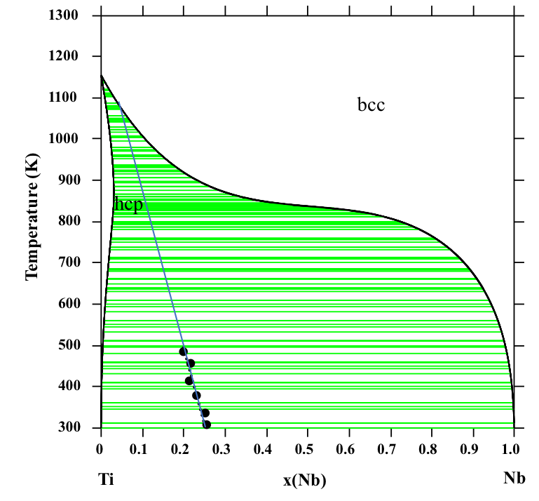
Ti-Nb Martensite
Study the elastic properties, phase fractions, transformation
4 compositions x(Nb)=0.1, 0.12, 0.18, 0.2
Two- 2 in by 2 in samples for each composition (arc melting)
Annealed
cold water quenched
Slow cooled
Studied at 1110, 900 500, 300 K
H.Y. Kim, Y. Ikehara, J.I. Kim, H. Hosoda, S. Miyazaki, Acta Mater. 54 (2006) 2419–2429.

Slide 30
Entropy difference between slow cooled and quenched samples
Phonon DOS show differences which concludes that they formed the different phases expected
Entropy difference between samples increases with increasing Nb
Further investigation is required to explain

Slide 31
Ti-Nb Diffraction Patterns and phase fractions
Alloy | x(Nb) | Phase Fraction
 |  | bcc | omega | Alpha”
Quenched | 0.10 | 0.12 | - | 0.88
 | 0.12 | 0.20 | - | 0.80
 | 0.18 | 0.57 | - | 0.43
 | 0.20 | 0.70 | - | 0.30
Slow Cooled | 0.10 | 0.20 | 0.80 | -
 | 0.12 | 0.30 | 0.70 | -
 | 0.18 | 0.60 | 0.40 | -
 | 0.20 | 0.70 | 0.30 | -
Alloy | x(Nb) | Phase Fraction
 |  | bcc | Alpha”
Friak | 0.10 | 0.06 | 0.94
 | 0.20 | 0.60 | 0.40
M. Friák et al., Materials (Basel)., vol. 5, no. 10, pp. 1853–1872, 2012.;

Slide 32
Summary
Established a thermodynamic database to predict the phase stabilities in the Ti-Mo-Nb-(Sn)-Ta-Zr system
Established a elastic database to predict the elastic properties of the BCC phase of the Ti-Mo-Nb-Sn-Ta-Zr system
Studied the elastic properties, phase stability and transformation of α” and ω phases

Slide 33
Future Work
Determine elastic properties of the Ti-Nb samples
Temperature dependence of the phonon DOS
DFT results will be used to model the α” and ω phases
New theoretic framework (partition function approach) to improve Helmholtz energy entropy values
Finish the thermodynamic modeling of the Sn binary and ternary systems
Introduce the hcp phase and interaction parameters for the non-Ti containing systems to the elastic database

Slide 34
Acknowledgements
Advisor-Dr. Liu
Collaborators- Dr. Ji-Cheng Zhao and Dr. Michael Manley
Committee members
Phases Research Lab
Family, boyfriend and friends
Funding Sources
DOE- Science Graduate Research Award
NSF-NRT funding
NSF-Ti Grant 1333999
NSF Grant No. ACI-1053575
DOE Grant No. DE-AC02-05CH11231

Slide 35
Backup Slides

Slide 36
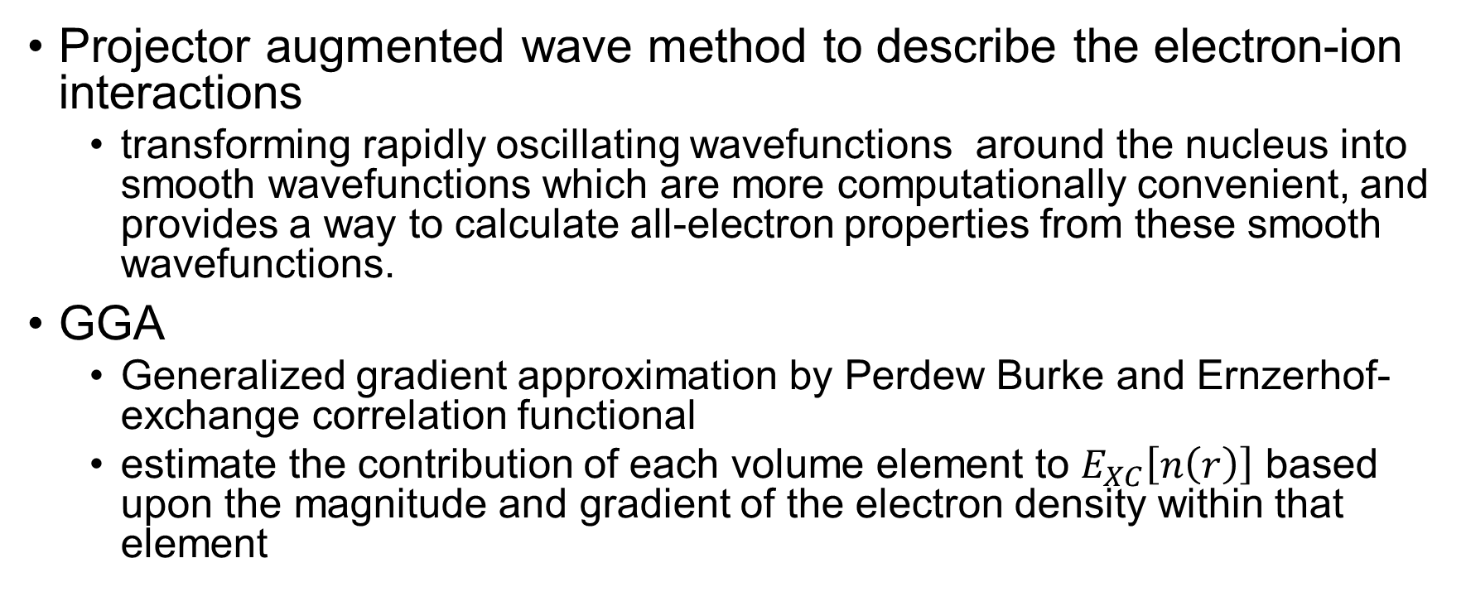
PAW
Projector augmented wave method to describe the electron-ion interactions
transforming rapidly oscillating wavefunctions around the nucleus into smooth wavefunctions which are more computationally convenient, and provides a way to calculate all-electron properties from these smooth wavefunctions.
GGA
Generalized gradient approximation by Perdew Burke and Ernzerhof-exchange correlation functional
estimate the contribution of each volume element to $E_{XC}\left[n\left(r\right)\right]$ based upon the magnitude and gradient of the electron density within that element
G. Kresse, D. Joubert, From ultrasoft pseudopotentials to the projector augmented-wave method, Phys. Rev. B. 59 (1999) 1758–1775.
J.P. Perdew, K. Burke, M. Ernzerhof, Phys. Rev. Lett. 77 (1996) 3865

Slide 37
PW91 vs PBE
PW91 is the first reasonable GGA that can be reliably used over a very wide range of materials.
PW91 contains much of the known correct physics of the exchange and correlation interactions.
PBE is based on PW91 containing the correct features of LDA but the correct (but hopefully not important!) features of PW91 that are ignored are:
Correct 2nd order gradient coefficients of ex and Ec in the slowly varying limit.
Correct non-uniform scaling of εx in the limits where s tend to infinity.
J.P. Perdew, K. Burke, M. Ernzerhof, Phys. Rev. Lett. 77 (1996) 3865

Slide 38
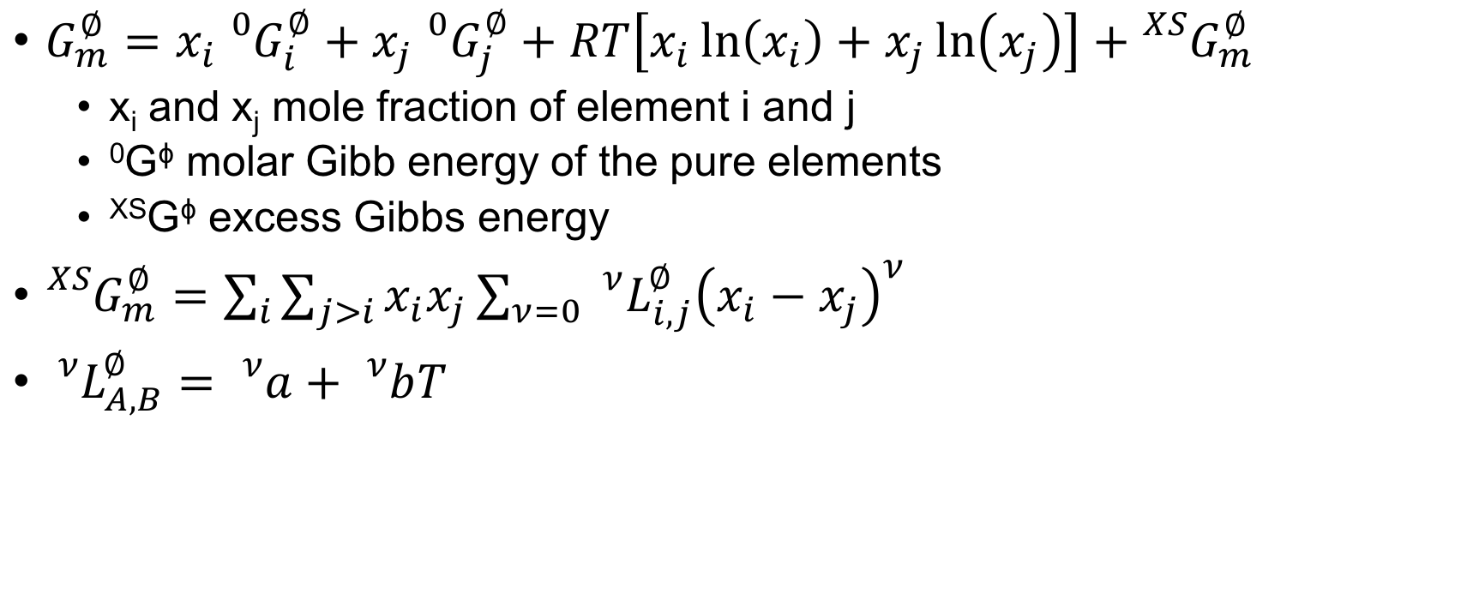
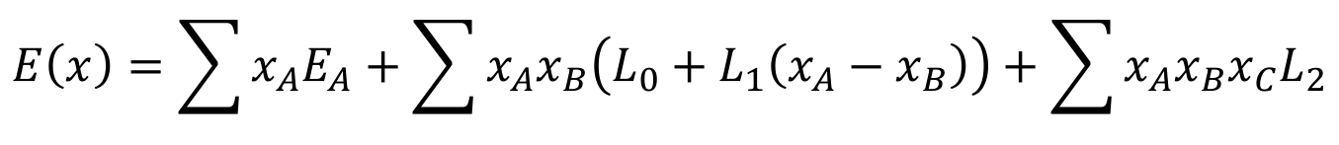
CALPHAD methodology binary solution phases
$G_{m}^{∅}=x_{i}{}_{}^{0}{G_{i}^{∅}+x_{j}{}_{}^{0}{G_{j}^{∅}+RT\left[x_{i}\ln\left(x_{i}\right)+x_{j}\ln\left(x_{j}\right)\right]+{}_{}^{XS}{G_{m}^{∅}}}}$
x_{i} and x_{j} mole fraction of element i and j
⁰G^{ϕ} molar Gibb energy of the pure elements
^{XS}G^{ϕ} excess Gibbs energy
${}_{}^{XS}{G_{m}^{∅}=\sum_{i}{\sum_{j>i}{x_{i}x_{j}}}\sum_{ν=0}{{}_{}^{ν}{L_{i,j}^{∅}{\left(x_{i}−x_{j}\right)}^{ν}}}}$
${}_{}^{ν}{L_{A,B}^{∅}}={}_{}^{ν}a+{}_{}^{ν}bT$
$$E\left(x\right)=\sum{x_{A}E_{A}}+\sum{x_{A}x_{B}\left(L_{0}+L_{1}\left(x_{A}−x_{B}\right)\right)}+\sum{x_{A}x_{B}x_{C}L_{2}}$$
Z.K. Liu, J. Phase Equilibria Diffus. 30 (2009) 517–534.

Slide 39
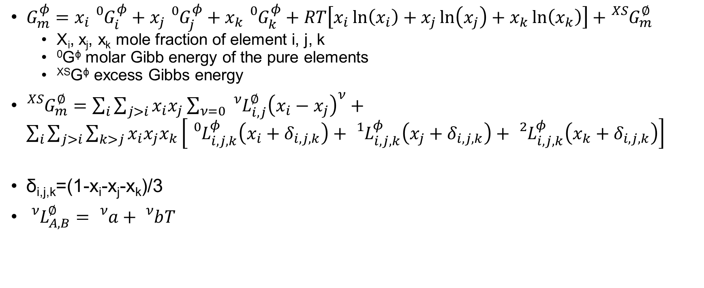
CALPHAD modeling ternary solution phases
$G_{m}^{φ}=x_{i}{}_{}^{0}{G_{i}^{φ}+x_{j}{}_{}^{0}{G_{j}^{φ}+x_{k}{}_{}^{0}{G_{k}^{φ}}+RT\left[x_{i}\ln\left(x_{i}\right)+x_{j}\ln\left(x_{j}\right)+x_{k}\ln\left(x_{k}\right)\right]+{}_{}^{XS}{G_{m}^{∅}}}}$
X_{i}, x_{j}, x_{k} mole fraction of element i, j, k
⁰G^{ϕ} molar Gibb energy of the pure elements
^{XS}G^{ϕ} excess Gibbs energy
${}_{}^{XS}{G_{m}^{∅}=\sum_{i}{\sum_{j>i}{x_{i}x_{j}}}\sum_{ν=0}{{}_{}^{ν}{L_{i,j}^{∅}{\left(x_{i}−x_{j}\right)}^{ν}}}}+\sum_{i}{\sum_{j>i}{\sum_{k>j}{x_{i}x_{j}x_{k}}}\left[{}_{}^{0}{L_{i,j,k}^{φ}\left(x_{i}+δ_{i,j,k}\right)+{}_{}^{1}{L_{i,j,k}^{φ}}\left(x_{j}+δ_{i,j,k}\right)+{}_{}^{2}{L_{i,j,k}^{φ}}\left(x_{k}+δ_{i,j,k}\right)}\right]}$
δ_{i,j,k}=(1-x_{i}-x_{j}-x_{k})/3
${}_{}^{ν}{L_{A,B}^{∅}}={}_{}^{ν}a+{}_{}^{ν}bT$
Z.K. Liu, J. Phase Equilibria Diffus. 30 (2009) 517–534.

Slide 40
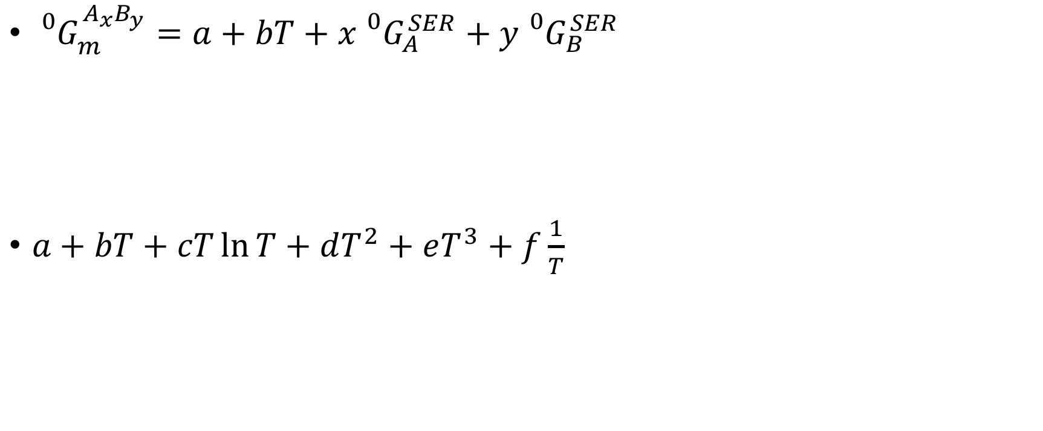
Calphad modeling stoichiometric compounds
${}_{}^{0}{G_{m}^{A_{x}B_{y}}=a+bT+x{}_{}^{0}{G_{A}^{SER}}+y{}_{}^{0}{G_{B}^{SER}}}$
$a+bT+cT\ln{T}+dT^{2}+eT^{3}+f\frac{1}{T}$
Z.K. Liu, J. Phase Equilibria Diffus. 30 (2009) 517–534.

Slide 41
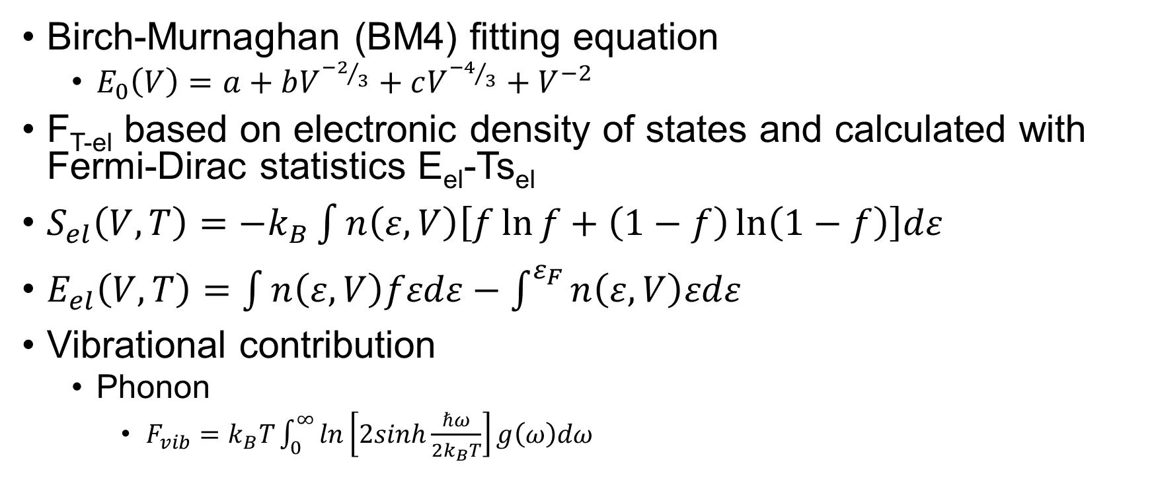
EOS Fitting, Debye Model, Phonon Model
Birch-Murnaghan (BM4) fitting equation
$E_{0}\left(V\right)=a+bV^{{−2}/3}+cV^{{−4}/3}+V^{−2}$
F_{T-el} based on electronic density of states and calculated with Fermi-Dirac statistics E_{el}-Ts_{el}
$S_{el}\left(V,T\right)=−k_{B}\int{n\left(ε,V\right)\left[f\ln{f}+\left(1−f\right)\ln\left(1−f\right)\right]dε}$
$E_{el}\left(V,T\right)=\int{n\left(ε,V\right)fεdε−\int^{ε_{F}}{n\left(ε,V\right)εdε}}$
Vibrational contribution
Phonon
$F_{vib}=k_{B}T\int_{0}^{∞}{ln\left[2sinh\frac{ℏω}{2k_{B}T}\right]g\left(ω\right)dω}$
Y. Wang, et al., Acta Mater. 52 (2004) 2665–2671.; S.L. Shang, et al. Comput. Mater. Sci. 47 (2010) 1040–1048.; A. Wang, et al., Calphad. 37 (2012) 126–131.

Slide 42
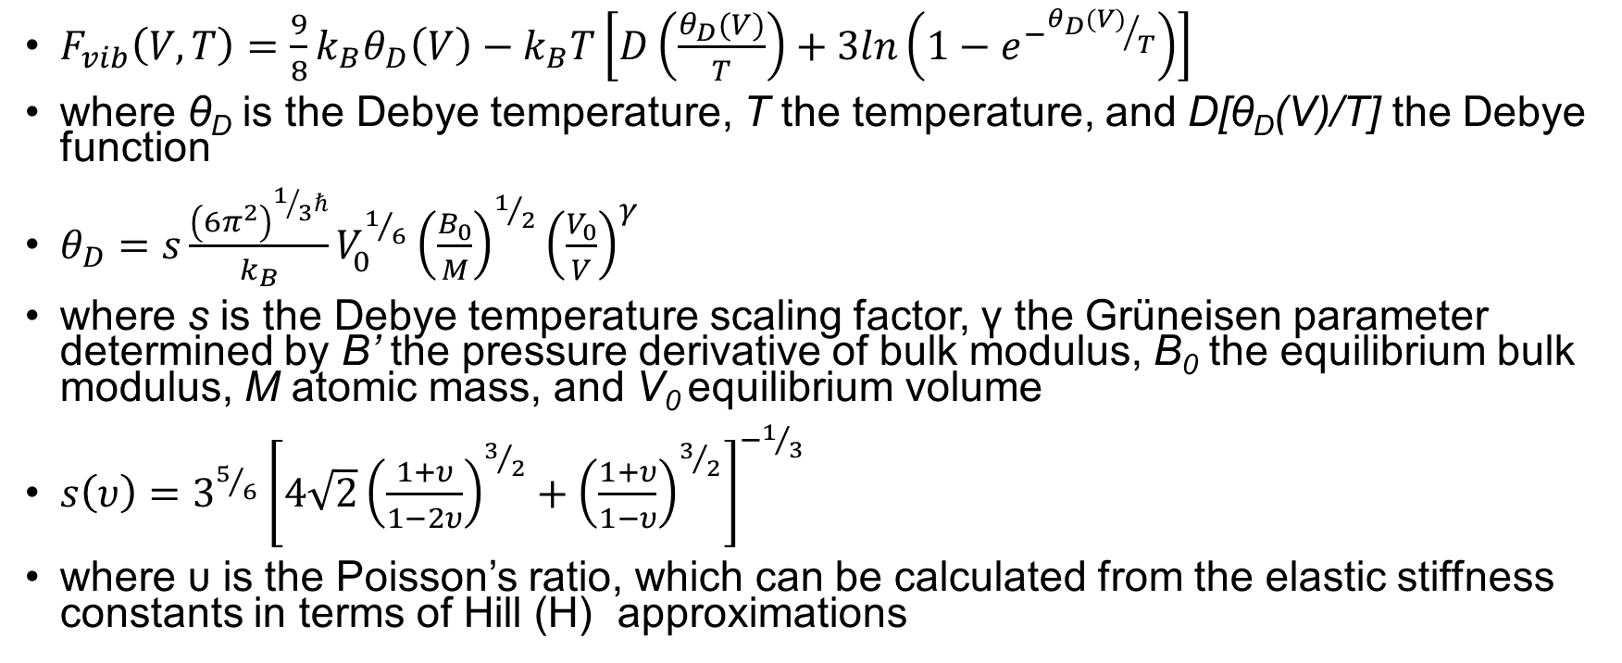
Debye Scaling Factor
$F_{vib}\left(V,T\right)=\frac{9}{8}k_{B}θ_{D}\left(V\right)−k_{B}T\left[D\left(\frac{θ_{D}(V)}{T}\right)+3ln\left(1−e^{−{θ_{D}(V)}/T}\right)\right]$
where θ_{D} is the Debye temperature, T the temperature, and D[θ_{D}(V)/T] the Debye function
$θ_{D}=s\frac{{\left(6π^{2}\right)}^{1/3ℏ}}{k_{B}}V_{0}^{1/6}{\left(\frac{B_{0}}{M}\right)}^{1/2}{\left(\frac{V_{0}}{V}\right)}^{γ}$
where s is the Debye temperature scaling factor, γ the Grüneisen parameter determined by B’ the pressure derivative of bulk modulus, B₀ the equilibrium bulk modulus, M atomic mass, and V₀ equilibrium volume
$s\left(υ\right)=3^{5/6}{\left[4\sqrt{2}{\left(\frac{1+υ}{1−2υ}\right)}^{3/2}+{\left(\frac{1+υ}{1−υ}\right)}^{3/2}\right]}^{−1/3}$
where υ is the Poisson’s ratio, which can be calculated from the elastic stiffness constants in terms of Hill (H) approximations
X.L. Liu et al., Comput. Mater. Sci. 98 (2015) 34–41.

Slide 43
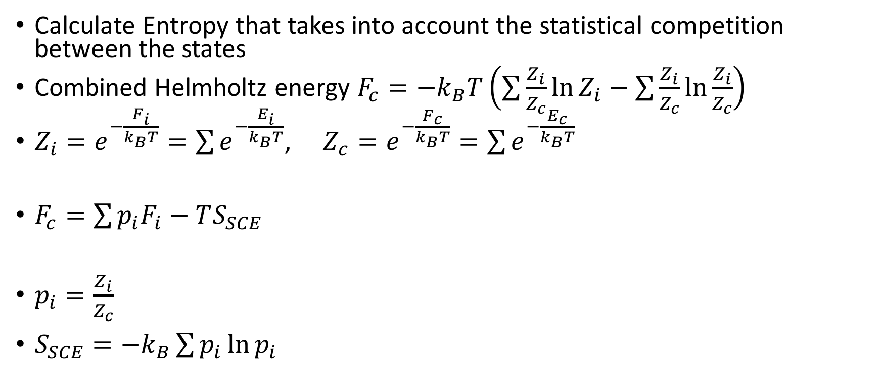
Partition Function Approach
Calculate Entropy that takes into account the statistical competition between the states
Combined Helmholtz energy $F_{c}=−k_{B}T\left(\sum{\frac{Z_{i}}{Z_{c}}\ln{Z_{i}}}−\sum{\frac{Z_{i}}{Z_{c}}\ln{\frac{Z_{i}}{Z_{c}}}}\right)$
$Z_{i}=e^{−\frac{F_{i}}{k_{B}T}}=\sum{e^{−\frac{E_{i}}{k_{B}T}}}$, $Z_{c}=e^{−\frac{F_{c}}{k_{B}T}}=\sum{e^{−\frac{E_{c}}{k_{B}T}}}$
$F_{c}=\sum{p_{i}F_{i}−TS_{SCE}}$
$p_{i}=\frac{Z_{i}}{Z_{c}}$
$S_{SCE}=−k_{B}\sum{p_{i}\ln{p_{i}}}$

Slide 44
Ti-Nb samples
x(Nb) 0.1, 0.12, 0.18, 0.2
Samples were made by arc melting
Cylindrical shapes 0.7 in diameter, 0.7 in thickness
Lindberg tube furnace to anneal at 1273 K 24 hours
Slow cooled and quenched

Slide 45
Neutron Scattering
ARCS- Angular-Range Chopper Spectrometer
Two incident neutron energies E=25meV and 50 meV at the 300 ,500, 700, 900, 1100 K temperatures
Vanadium sample holders-low coherent scattering for neutrons
Diffraction-elastic scattering, distance between scattering planes and modeled as a Gaussian function
phonon DOS using an iterative method to remove the elastic and multi-phonon contributions
Multi-phonon scattering event-is when multiple phonons are involved
Single phonon scattering event-phonon frequencies and eigenvectors
Coherent-depends on direction of q
Incoherent-scattering is uniform in all directions

Slide 46
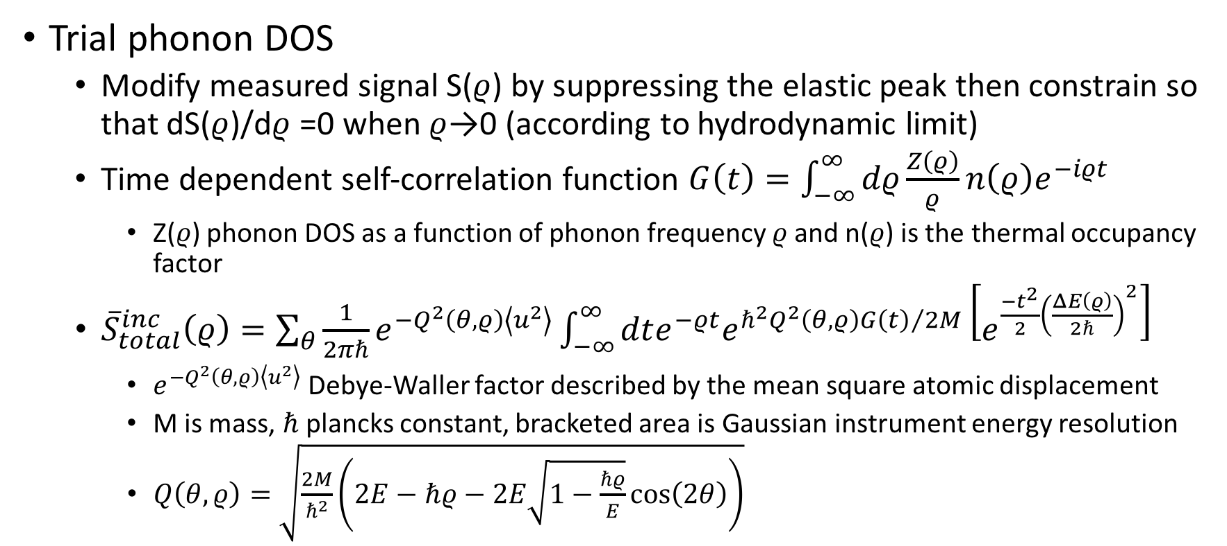
Phonon DOS
Trial phonon DOS
Modify measured signal S($ρ$) by suppressing the elastic peak then constrain so that dS($ρ$)/d$ρ$ =0 when $ρ$→0 (according to hydrodynamic limit)
Time dependent self-correlation function $G\left(t\right)=\int_{−∞}^{∞}{dρ\frac{Z\left(ρ\right)}{ρ}n\left(ρ\right)e^{−iρt}}$
Z($ρ$) phonon DOS as a function of phonon frequency $ρ$ and n($ρ$) is the thermal occupancy factor
${\overline{S}}_{total}^{inc}\left(ρ\right)=\sum_{θ}{\frac{1}{2πℏ}e^{−Q^{2}\left(θ,ρ\right)\left\langle u^{2}\right\rangle }}\int_{−∞}^{∞}{dte^{−ρt}e^{ℏ^{2}Q^{2}\left(θ,ρ\right){G\left(t\right)}/{2M}}\left[e^{\frac{−t^{2}}{2}{\left(\frac{ΔE\left(ρ\right)}{2ℏ}\right)}^{2}}\right]}$
$e^{−Q^{2}\left(θ,ρ\right)\left\langle u^{2}\right\rangle }$ Debye-Waller factor described by the mean square atomic displacement
M is mass, $ℏ$ plancks constant, bracketed area is Gaussian instrument energy resolution
$Q\left(θ,ρ\right)=\sqrt{\frac{2M}{ℏ^{2}}\left(2E−ℏρ−2E\sqrt{1−\frac{ℏρ}{E}}\cos\left(2θ\right)\right)}$

Slide 47
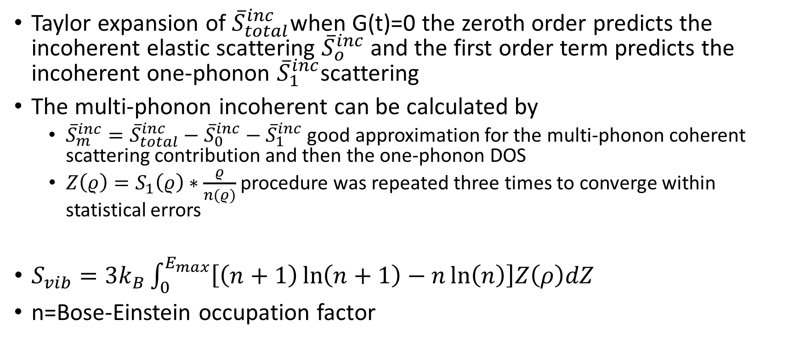
Phonon DOS
Taylor expansion of ${\overline{S}}_{total}^{inc}$when G(t)=0 the zeroth order predicts the incoherent elastic scattering ${\overline{S}}_{o}^{inc}$and the first order term predicts the incoherent one-phonon ${\overline{S}}_{1}^{inc}$scattering
The multi-phonon incoherent can be calculated by
${\overline{S}}_{m}^{inc}={\overline{S}}_{total}^{inc}−{\overline{S}}_{0}^{inc}−{\overline{S}}_{1}^{inc}$ good approximation for the multi-phonon coherent scattering contribution and then the one-phonon DOS
$Z\left(ρ\right)=S_{1}\left(ρ\right)∗\frac{ρ}{n(ρ)}$ procedure was repeated three times to converge within statistical errors
$S_{vib}=3k_{B}\int_{0}^{E_{max}}{\left[\left(n+1\right)\ln\left(n+1\right)−n\ln\left(n\right)\right]Z\left(ρ\right)dZ}$
n=Bose-Einstein occupation factor

Slide 48
Ti-X Relaxation Calculations
Alloy | Length | Alloy | Length | Alloy | Length | Alloy | Length
Ti | 50 | Mo | 50 | 75Ti25Sn | 4x4x4 | 25Ti75Ta | 4x4x4
Ti15Mo | 80 | Ti53Nb | 4x4x4 | 50Ti50Sn | 80 | Ta | 50
Ti7Mo | 80 | Ti7Nb | 4x4x4 | 25Ti75Sn | 4x4x4 | Ti53Zr | 3x3x3
75Ti25Mo | 4x4x4 | 75Ti25Nb | 4x4x4 | Sn | 50 | 75Ti25Zr | 4x4x4
50Ti50Mo | 4x4x4 | 50Ti50Nb | 4x4x4 | Ti53Ta | 80 | 50Ti50Zr | 4x4x4
25Ti75Ti | 4x4x4 | 25Ti75Nb | 4x4x4 | Ti7Ta | 80 | 25Ti75Zr | 4x4x4
Mo15Ti | 80 | Nb | 50 | 75Ti25Ta | 5x5x5 | Zr15Ti | 80
Mo53Ti | 50 | Ti15Sn | 80 | 50Ti50Ta | 4x4x4 | Zr | 50
Gamma centered Monkhorst-Pack grids; NSW=50, ENCUT 310, High Precision, SQS are 16-atom
Notes:
$N_{1}=max\left(1,l∗\left|\vec{b_{1}}\right|+0.5\right)$--either specify length with the 10 large gap insulators and 100 d-metals, AxAxA where the subdivisions of N_1, N_2, N_3 along reciprocal lattice vectors

Slide 49
Ti-X-Y Relaxation Calculations
3 ternary SQS calculations
TiXY- 12-Ti, 12-X, 12-Y
Ti2XY- 16-Ti, 8-X, 8-Y
Ti6XY- 48-Ti, 8-X, 8-Y
KPOINTS were gamma centered M-P 4x4x4
X0.5Y0.5 16 atom cell
KPOINTS were gamma centered M-P 80
Encut 310
High Precision
Sigma 0.2
NSW 50

Slide 50
Thermodynamic Modeling-Binary Systems
W. Xiong, Y. Du, Y. Liu, B.Y. Huang, H.H. Xu, H.L. Chen, Z. Pan, Calphad-Computer Coupling Phase Diagrams Thermochem. 28 (2004) 133–140 .

Slide 51
Thermodynamic Modeling-Binary Systems
R.J. Perez, B. Sundman, Calphad-Computer Coupling Phase Diagrams Thermochem. 27 (2003) 253–262.; J.P. Abriata, J.C. Bolcich, Bull. Alloy Phase Diagrams. 3 (1982) 34–44.; A.F. Guillermet,, J. Alloys Compd. 226 (1995) 174–184.

Slide 52
Thermodynamic Modeling-Ti-Mo
I. Ansara, A.T. Dinsdale, M.H. Rand,, European Communities, Brussels and Luxembourg, 1998.; J.L. Murray, Bull. Alloy Phase Diagrams. 2 (1981) 185–192.; T. Uesugi, S. Miyamae, K. Higashi, Mater. Trans. 54 (2013) 484–492.

Slide 53
Thermodynamic Modeling-Ti-Ta
J.L. Murray, ASM Int. (1987) 354.; I. Ansara, A.T. Dinsdale, M.H. Rand, European Communities, Brussels and Luxembourg, 1998.

Slide 54
Thermodynamic Modeling-Ti-Zr
K.C.H. Kumar, P. Wollants, L. Delaey, J. Alloys Compd. 206 (1994) 121–127

Slide 55
Thermodynamic Modeling-Ti-Mo-Nb
o-phase boundary
•-single-phase
◑-two-phase
873 K
L. Na, W.H. Warnes, Ieee Trans. Appl. Supercond. 11 (2001) 3800–3803.

Slide 56
Thermodynamic Modeling-Ti-Mo-Nb
o-phase boundary
•-single-phase
◑-two-phase
873 K
D.A. Prokoshkin, M.I. Zakharova, in: Akad. Nauk SSSR, Dokl., 1967: pp. 1382–1384.; J.J. English, DTIC Document, 1961.

Slide 57
Thermodynamic Modeling-Ti-Mo-Ta
o-phase boundary
•-single-phase
◑-two-phase
Phase | Parameters | Value
BCC_A2 (Ti,Mo,Ta) |  | -15731.2
873 K
a
b
P.N. Nikitin, V.S. Mikheyev, Russ. Metall. (1971) 144–147

Slide 58
Thermodynamic Modeling-Ti-Mo-Zr
o-phase boundary
•-single-phase
◑-two-phase
S. Kar, D.M. Lipkin, in: TMS 2008 Annu. Meet. Suppl. Proceedings, Vol 2 Mater. Charact. Comput. Model., Minerals, Metals & Materials Soc, Warrendale, 2008: pp. 237–243.; D.A. Prokoshkin, M.I. Zakharova, in: Akad. Nauk SSSR, Dokl., 1967: pp. 1382–1384

Slide 59
Thermodynamic Modeling-Ti-Nb-Zr
o-phase boundary
•-single-phase
◑-two-phase
1273 K
1773 K
L. Lin, L. Delaey, O. VanDerBiest, P. Wollants, Scr. Mater. 34 (1996) 1411–1416.; M. Hoch, D.B. Butrymow, Trans. Metall. Soc. AIME. 230 (1964) 186–192

Slide 60
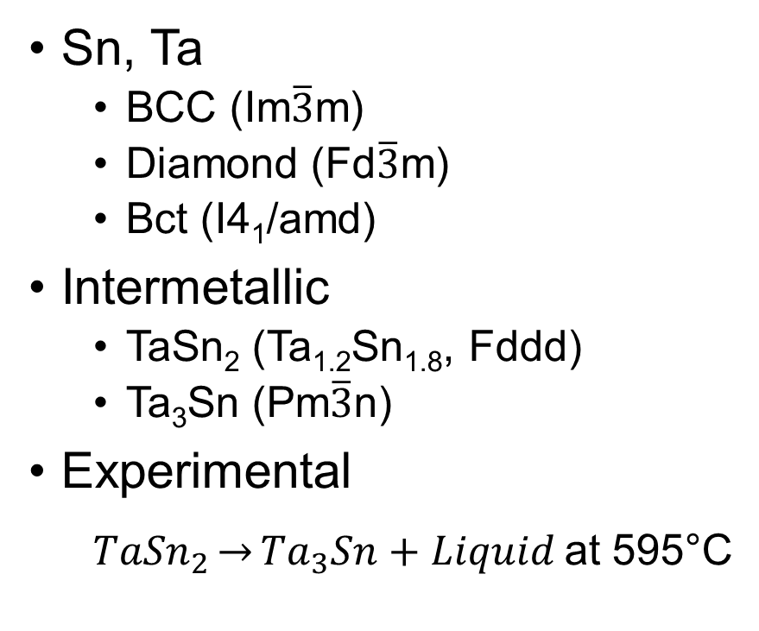
Sn-Ta System
Sn, Ta
BCC (Im$\overline{3}$m)
Diamond (Fd$\overline{3}$m)
Bct (I4₁/amd)
Intermetallic
TaSn₂ (Ta_{1.2}Sn_{1.8}, Fddd)
Ta₃Sn (Pm$\overline{3}$n)
Experimental
${TaSn}_{2}\underset{→}{}{Ta}_{3}Sn+Liquid$at 595°C
H. Okamoto, Sn-Ta (Tin-Tantalum), J. Phase Equilibria. 24 (2003) 484.
Notes:
Monkhorst pack shceme and an energy cutoff of 300 ev 54

Slide 61
Sn-Ta Calculation Details
Element | Calculation | Unit Cell Size | Encut (eV) | KPOINTS subdivision
Beta-Sn | EOS/Debye 0.617 | 4 atoms | 80 | 320
 | Phonon | 48 atoms | 80 | 320
Diamond-Sn | EOS/Debye | 8 atoms | 150 | 150
 | Phonon | 32 atoms | 4x4x4 | 300
Bcc-Ta | EOS/Debye 0.617 | 54 atoms | 6x6x6 | 313
 | Phonon | 54 atoms | 5x5x5 | 313
Bcc-Sn | EOS/Debye | 54 atoms | 6x6x6 | 337
Ta₃Sn | EOS/Debye 0.389 | 8 atoms | 50 | 300
 | Elastic | 8 atoms | 80 | 300
 | Phonon | 64 atoms | 80 | 300
TaSn₂ | EOS/Debye 0.789 | 12 atoms | 10x10x5 | 300
 | Elastic | 12 atoms | 4x4x4 | 300
 | Phonon | 96 atoms | 80 | 300
SQS | EOS | 16 atoms | 80 | 300
$N_{1}=max\left(1,l∗\left|\vec{b_{1}}\right|+0.5\right)$ N₂, l, b₂ N₃, l, b₃
$$\vec{k}=\vec{b_{1}}\frac{n_{1}}{N_{1}}+\vec{b_{2}}\frac{n_{2}}{N_{2}}+\vec{b_{3}}\frac{n_{3}}{N_{3}}$$

Slide 62
Scaling Factor
 | TaSn₂ |  | Ta₃Sn
 | Present work | FP [43,44,46,47] | Present work 8 atoms | Present work 32 atoms | FP [44–47]
C₁₁ (GPa) | 166 | 161 | 297 | 310 | 226
C₁₂ (GPa) | 79 | 78 | 127 | 131 | 155
C₁₃ (GPa) | 62 | 57
C₂₂ (GPa) | 189 | 182
C₂₃ (GPa) | 68 | 68
C₃₃ (GPa) | 187 | 183
C₄₄(GPa) | 37 | 35 | 65 | 68 | 22
C₅₅ (GPa) | 59 | 55
C₆₆ (GPa) | 61 | 60
Young’s Modulus (GPa) | 135 |  | 210 | 202
Shear Modulus (GPa) | 53 | 51 | 80 | 76 | 27
Poisson Ratio | 0.288 | 0.29 | 0.32 | 0.32 | 0.43
Scaling factor | 0.789 |  | 0.71 | 0.71
B_{cij} (GPa) | 107 | 107 | 184 | 190 | 179
B_{EOS} (GPa) | 104 |  | 182

Slide 63
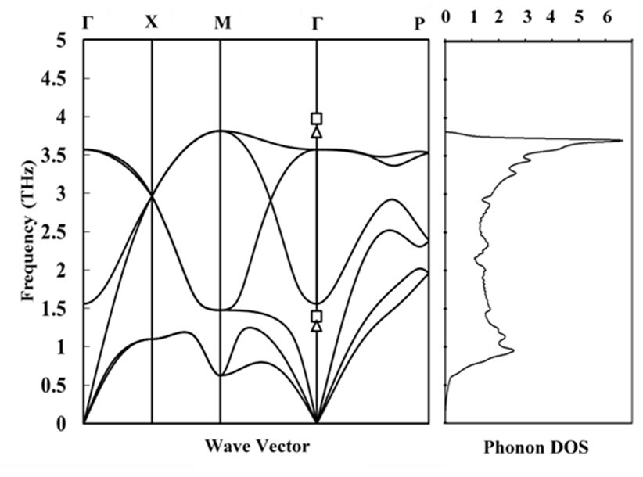
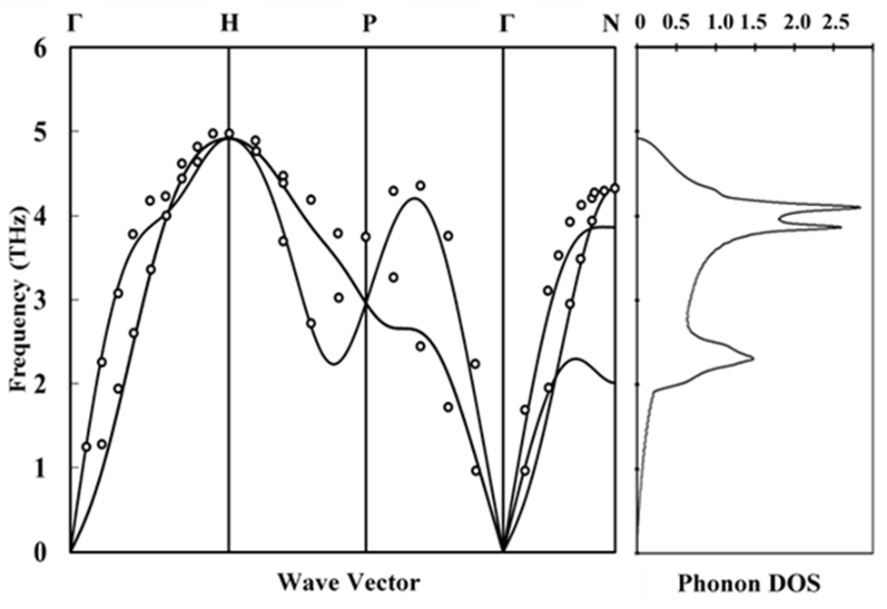
Dispersion Curves Sn and Ta
Calculated phonon dispersion curve of bct-Sn is on the left. The squares (□) are the LO and TO modes found from neutron scattering at 110 K. The triangles (∆) are the LO and TO modes found from Raman at ambient pressures [1].
Calculated phonon dispersion curve of bcc-Ta, was compared with neutron diffraction experiments (○) [2]. The values for phonon DOS have no meanings, the same for other figures.
H. Olijnyk, Phys. Rev. B. (1992).; S. Taioli et al., Phys. Rev. B. 75 (2007) 214103.

Slide 64
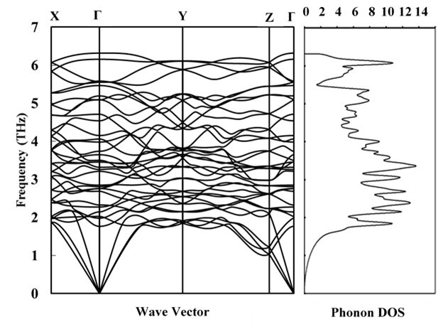
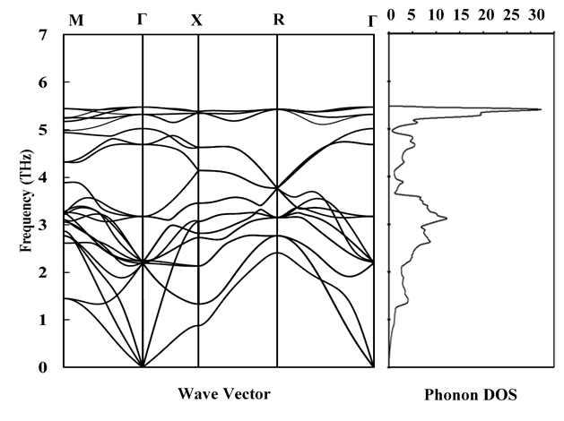
Dispersion Curves TaSn₂ and Ta₃Sn
Calculated phonon dispersion curve for TaSn₂ at 0 K.
Calculated phonon dispersion curve of Ta3Sn is calculated on the left at 0 K.

Slide 65
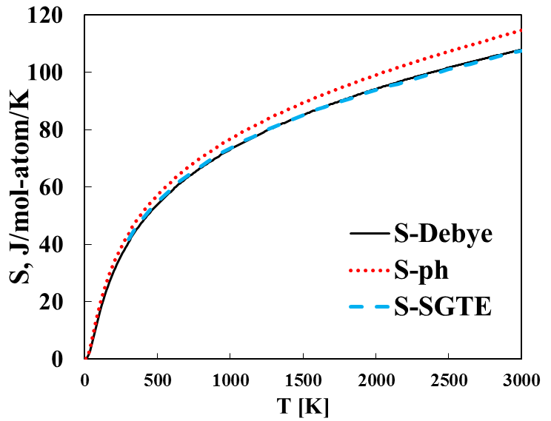
bcc-Ta Results
Lattice parameter (Å) | V (Å³/atom) | B (GPa) | Reference
3.316 3.328 3.330 | 18.241 | 193.7 | This work EOS (0 K) Phonon (298 K) Debye (298 K)
3.30 | 17.969 | 200 | Expt. [1]
3.32 | 18.313 | 195.3 | DFT [2]
[1] R. Predmore et al., Scr. Metall. 4 (1970) 213–217. [2] S.L. Shang et al., Comput. Mater. Sci. 48 (2010) 813–826.

Slide 66
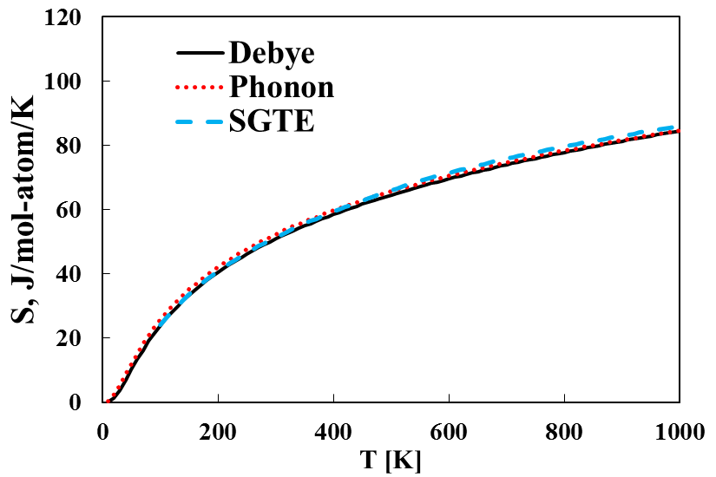
bct-Sn Results
Lattice parameter (Å) |  | V (Å³/atom) | B (GPa) | Reference
a | c
5.939 5.994 5.954 | 3.214 3.244 3.222 | 28.431 | 47.7 | This Work EOS (0K) Phonon (298 K) Debye (298 K)
5.83 | 3.18 | 27.055 | 58.0 | Expt. [1-2]
5.93 | 3.23 | 28.396 | 54.0 | DFT [2-3]
[1] W.P. Allen et al., Metall. Trans. A. 22 (1991) 753–764. [2] E. Peltzer et al., Phys. Rev. B. 48 (1993) 15712–15718. [3] R. Arróyave et al., Phys. Rev. B. (2006).

Slide 67
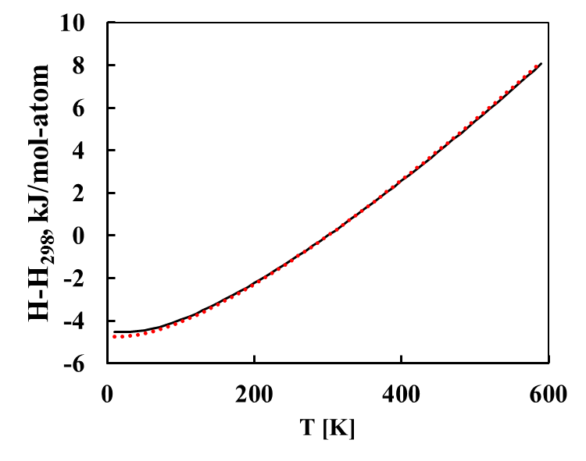
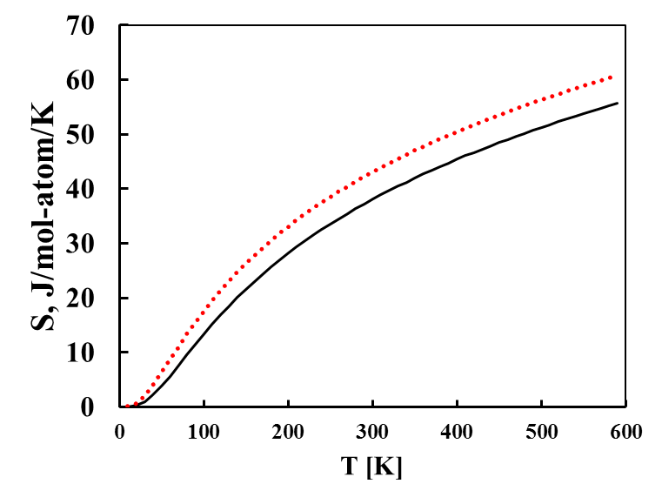
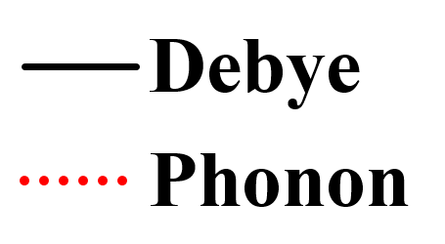
TaSn₂ Results
Lattice parameter (Å) |  |  | V (Å³/atom) | B (GPa) | Reference
a | b | c
5.641 5.695 5.652 | 9.766 9.854 9.785 | 19.200 19.386 19.238 | 22.631 | 104.3 | This work EOS (0 K) Phonon (298 K) Debye (298 K)
5.63 | 9.80 | 19.18 |  |  | Expt [1]
L. Calvert, P. Villars, ASM, Mater. Park. OH. (1991).

Slide 68
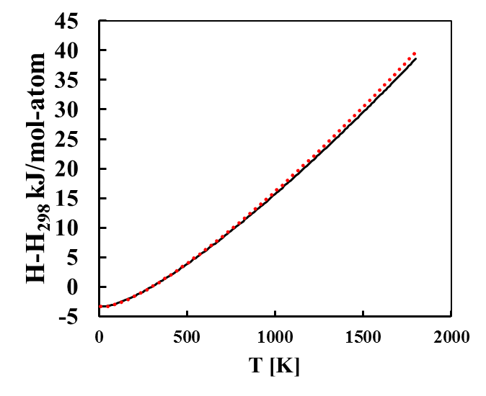

Ta₃Sn Results
Lattice parameter (Å) | V (Å³/atom) | B (GPa) | Reference
5.304 5.319 5.319 | 18.668 | 182.4 | This work EOS (0 K) Phonon (298 K) Deybe (298 K)
5.29 |  |  | Expt [1]
T.H. Courtney et al., J. Appl. Phys. 36 (1965) 3256–3260.

Slide 69

Phase Diagram
Nb
Sn
C. Toffolon et al., J. Phase Equilibria. 23 (2002) 134–139.

Slide 70

TaSn₂ Results

Slide 71

Ta₃Sn Results

Slide 72
Phase (model) | Modeled Parameters
bcc_A2 (Sn,Ta) | $${}_{}^{0}{L_{Ta,Sn}^{bcc}=70451}$$
 | $${}_{}^{1}{L_{Ta,Sn}^{bcc}=112237}$$
Liquid (Sn,Ta) | $${}_{}^{0}{L_{Ta,Sn}^{Liq}=−17118}$$
TaSn₂ | $$G^{Ta{Sn}_{2}}=2{}_{}^{0}{G_{Sn}^{bct}+{}_{}^{0}{G_{Ta}^{bcc}}−29678−4.202T}$$
Ta₃Sn | $$G^{{Ta}_{3}Sn}={}_{}^{0}{G_{Sn}^{bct}+3{}_{}^{0}{G_{Ta}^{bcc}}−68844−6.000T}$$

Slide 73

Liquid Enthalpy of Mixing
C. Toffolon et al., J. Phase Equilibria. 23 (2002) 134–139.

Slide 74

Elastic Theory
A set of strains (ε₁, ε₂, ε₃, ε₄, ε₅, ε₆) ε₁, ε₂, ε₃ are normal strains and ε₄, ε₅, ε₆ are shear strains
$L_{def}=L\left(\begin{matrix}1+ε_{1} & {ε_{6}}/2 & {ε_{5}}/2 \\ {ε_{6}}/2 & 1+ε_{2} & {ε_{4}}/2 \\ {ε_{5}}/2 & {ε_{4}}/2 & 1+ε_{3}\end{matrix}\right)$
Generate a set of stresses use hooks law
Apply linearly independent set of strains to the supercell
$\left(\begin{matrix}x & 0 & 0 & 0 & 0 & 0 \\ 0 & x & 0 & 0 & 0 & 0 \\ 0 & 0 & x & 0 & 0 & 0 \\ 0 & 0 & 0 & x & 0 & 0 \\ 0 & 0 & 0 & 0 & x & 0 \\ 0 & 0 & 0 & 0 & 0 & x\end{matrix}\right)$
S.L. Shang et al., Appl. Phys. Lett. 90 (2007) 101909.

Slide 75

Voigt-Reuss-Hill
${\overline{C}}_{11}=\frac{\left(c_{11}+c_{22}+c_{33}\right)}{3}$, ${\overline{C}}_{12}=\frac{\left(c_{12}+c_{13}+c_{23}\right)}{3}$, ${\overline{C}}_{44}=\frac{\left(c_{44}+c_{55}+c_{66}\right)}{3}$
$B_{V}={\left({\overline{C}}_{11}+2{\overline{C}}_{12}\right)}/3$, $B_{R}=1/{\left(3{\overline{S}}_{11}+6{\overline{S}}_{12}\right)}$
$G_{V}={\left({\overline{C}}_{11}−{\overline{C}}_{12}+3{\overline{C}}_{44}\right)}/5$, $G_{R}=5/{\left(4{\overline{S}}_{11}+6{\overline{S}}_{12}\right)}$
$E_{V}={\left(9B_{V}G_{V}\right)}/{\left(3B_{V}+G_{V}\right)}$, $E_{R}={\left(9B_{R}G_{R}\right)}/{\left(3B_{R}+G_{R}\right)}$
$B_{H}={\left(B_{V}+B_{R}\right)}/2$, $G_{H}={\left(G_{V}+G_{R}\right)}/2$
$E_{H}={\left(9B_{H}G_{H}\right)}/{\left(3B_{H}+G_{H}\right)}$
Stability
$c_{11}−\left|c_{12}\right|>0$
$c_{11}+2c_{12}>0$
$c_{44}>0$

Slide 76
X-C Functional Comparison
a
b
c
d

Slide 77
Strain Rate Comparison
a
b
c
d

Slide 78
Ti-X C₁₁

Slide 79
Ti-X-Y C₁₁

Slide 80
Ti-X-Y C₁₁

Slide 81
Ti-X C₁₂

Slide 82
Ti-X-Y C₁₂

Slide 83
Ti-X-Y C₁₂

Slide 84
Ti-X C₄₄

Slide 85
Ti-X-Y C₄₄

Slide 86
Ti-X-Y C₄₄

Slide 87
C₁₁-C₁₂

Slide 88
Ti-X E

Slide 89
Ti-X-Y E

Slide 90
Ti-X-Y E

Slide 91
Ti-X B

Slide 92
Ti-X-Y B

Slide 93
Ti-X-Y B

Slide 94
Ti-X G

Slide 95
Ti-X-Y G

Slide 96
Ti-X-Y G

Slide 97











Slide 99

$α$”

Slide 100

$$ω$$

Slide 101
hcp

